Slide 1

Smart Mirror
Presentation Report
Submitted to Submitted By
Guide Name: Prof. Anil Patidar Students Name: ShahRukh Khan, Designation: (HOD. MCA) Roll No.: EN17CA501080

Slide 2
INDEX
Introduction
Raspberry Pi 3 Configuration
Control Diagram
Things Managed by Remote Device
Voice Recognition Flow
Complete Proposed Model
Troubleshooting Guide

Slide 3
INTRODUCTION
The two-way mirror is made of acrylic and sits over the monitor, allowing the graphics on the monitor to reflect through while maintaining a mirror effect.
Users can create their customized display, Some informational displays contain information aggregated from third party APIs, such as social media feeds, news feeds, and weather updates
The mirror has the ability to display widgets.
The mirror functions as a mirror.
A mirror that shows you handy information before starting your day?
Adding voice controls so that you can update your calendar, play Spotify playlists, and so much more.

Slide 4
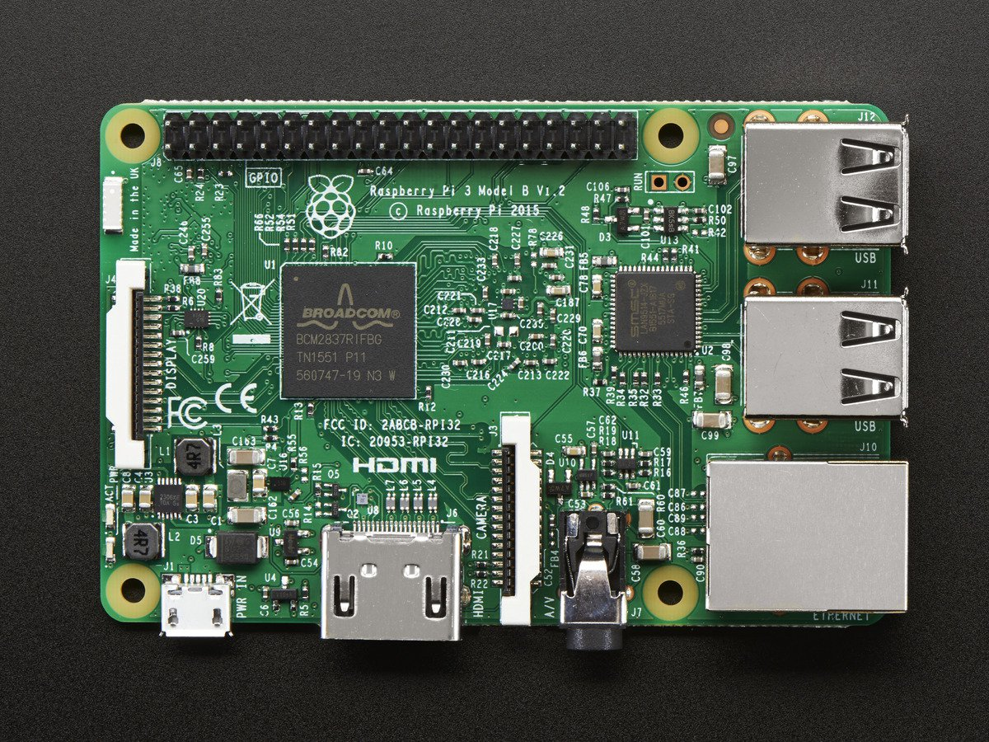
Raspberry Pi 3 Configuration
The Raspberry configured to use its own Official Operating System i.e. Raspbian Jessie.
Update and Upgrade with This Command:
“sudo apt-get update && apt-get upgrade -y”

Slide 5
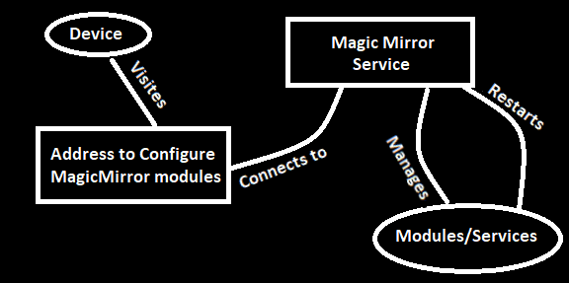
Control Diagram

Slide 6
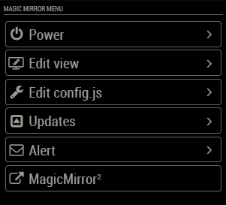
These are the things that can be managed remotely by any device.

Slide 7
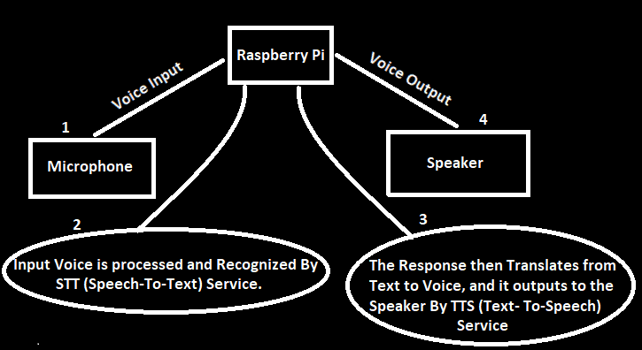
Voice Recognition Flow

Slide 8
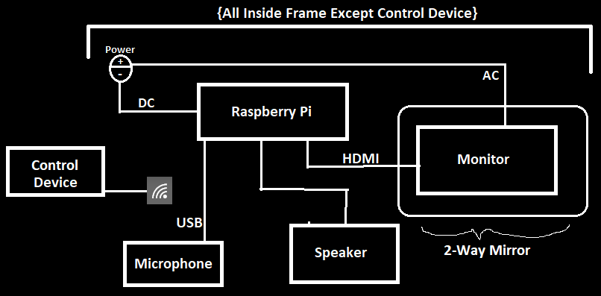
Complete Proposed Model

Slide 9
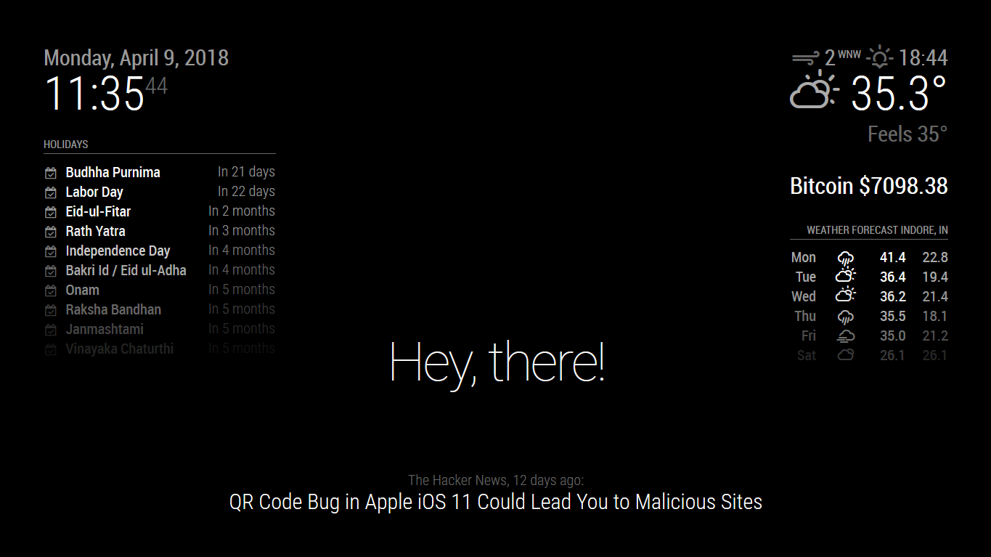
Sample Output

Slide 10
Troubleshooting Guide
Error: STT engine 'sphinx' is not available:
Install the pocketsphinx and python-pocketsphinx and its dependencies.
Fix for slow mouse on Raspberry Pi:
add “usbhid.mousepoll=0” to /boot/cmdline.txt
in the same line separated from the other stuff by spaces
Connect to wifi with command line:
Search: “sudo iwlist wlan0 scan”
Now you need to add your Wi-Fi settings to the wpa-supplicant configuration file.
Type the following in the command line to the configuration file:
“sudo nano /etc/wpa_supplicant/wpa_supplicant.conf”
Go to the bottom of the file and add the following Wi-Fi setting, adding your setting in the quotation marks.
network={
ssid="The_ESSID_from_earlier"
psk="Your_wifi_password"
}

